Slide 1
Deep Learning in R: Convolutional Neural Network

Slide 2
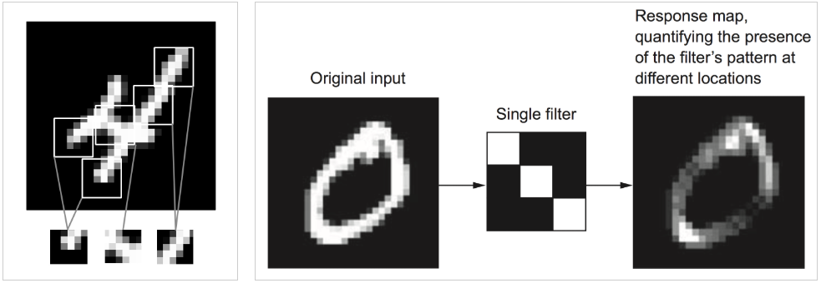
Keras API: Convolutional Layers
Filters for learning local (translation invariant) patterns in data
layer_conv_2d()

Slide 3
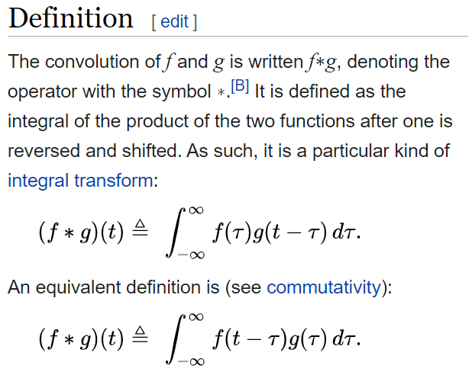
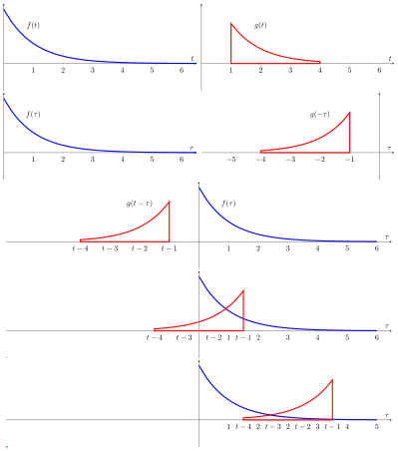
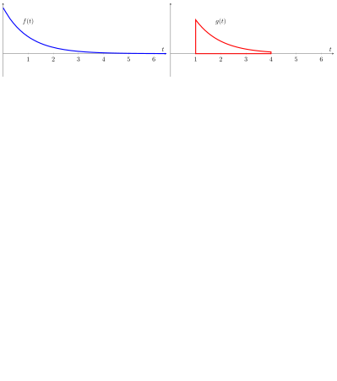
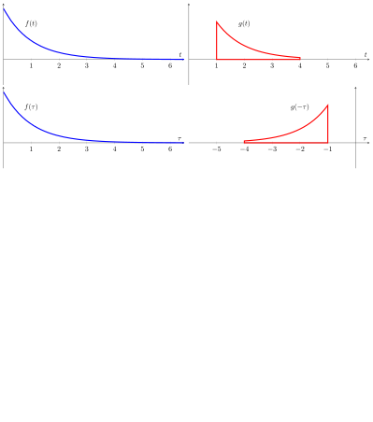
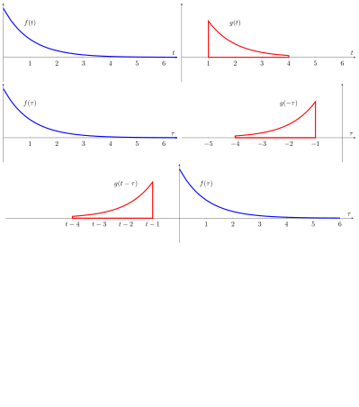
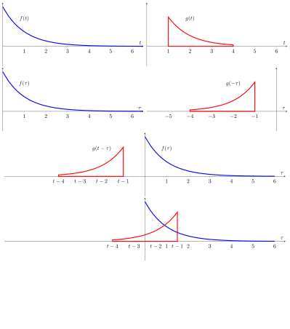

Convolution (Mathematical Definition)

Slide 4
Convolution in Engineering world
In mathematics, Convolution is an operation which does the integral of the product of 2 functions (e.g., 2 signals), with one of the signals flipped.
X
0 | 1 | 2 | 3 | 3
W
1 | -1 | 2
2 | -1 | 1
0 | 1 | 2 | 3 | 3
1 * 0 = 0
0 | 1 | 2 | 3 | 3
3
2 | -1 | 1
2 | -1 | 1
0 | 1 | 2 | 3 | 3
4
0 | 1 | 2 | 3 | 3
(-1 * 0) + (1 * 1) = 1
2 | -1 | 1
2 | -1 | 1
0 | 1 | 2 | 3 | 3
3
0 | 1 | 2 | 3 | 3
(0 * 2) + (-1 * 1) + (2 * 1) = 1
2 | -1 | 1
2 | -1 | 1

Slide 5
Convolution
0 | 1 | 2 | 3 | 3
6
2 | -1 | 1
Output: X
0 | 1 | 1 | 3 | 4 | 3 | 6

Slide 6
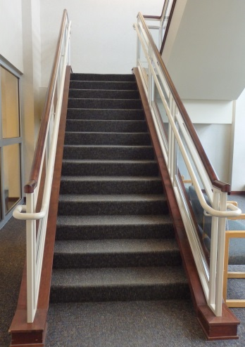
Convolutional Neural Networks: Why?
Why do shallow fully connected neural networks not work when the input is an image?
There are two main reasons:
(1) The input consists of 42,000 numbers, therefore many weights are needed for each node in the hidden Layer. Saying 100 nodes in the first layer, this corresponds to 4,200,000 weight parameters required to define only this layer. More parameters mean that more training data is needed to prevent overfitting. This leads to more time required to train the model.
(2) Processing by Fully Connected Deep Feed Forward Networks requires that the image data be transformed into a linear 1-D vector. This results in a loss of structural information, including correlation between pixel values in 2-D.
[100 * 140 * 3] = 42,000

Slide 7

Convolutional Neural Networks: The layers
Image from: http://cs231n.github.io/convolutional-networks/

Slide 8
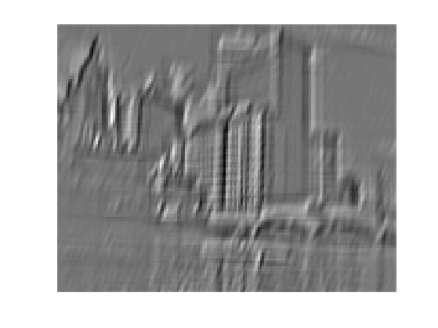
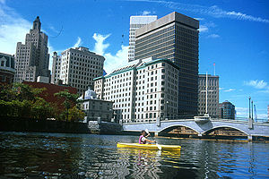
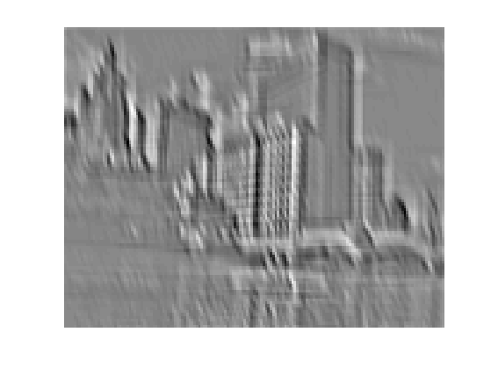
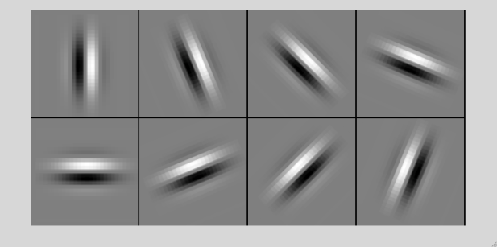
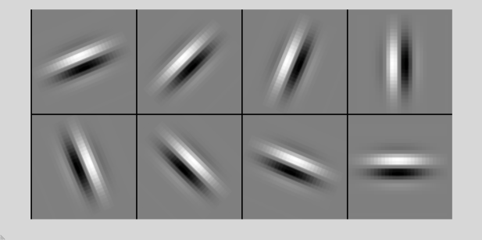
Convolution as feature extraction
bank of K filters
K feature maps
...
image
feature map

Slide 9
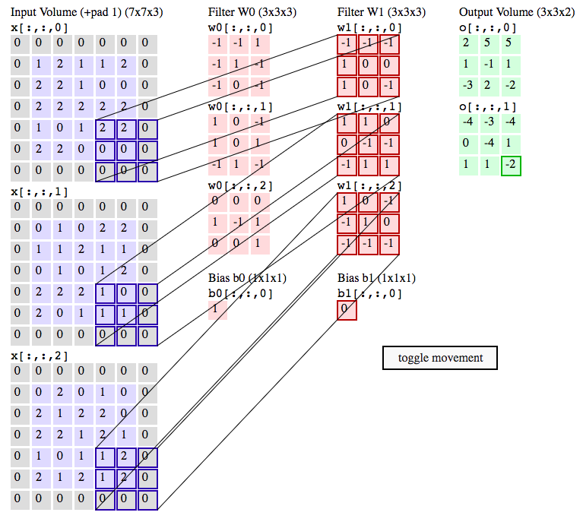

Convolutional layer demo
http://cs231n.github.io/convolutional-networks/#conv

Slide 10
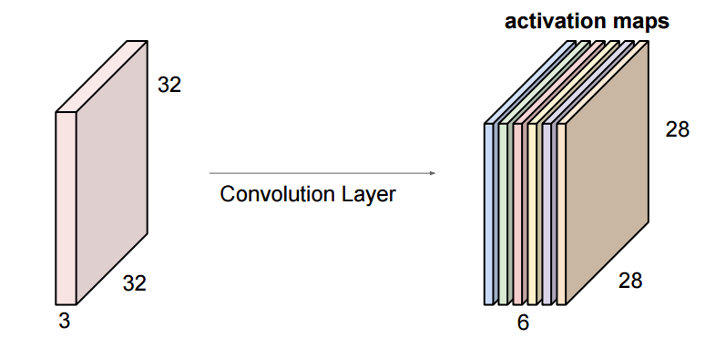
Convolutional layer
In CNN, we are working with multiple filters. Each filter looks for a specific kind of feature/pattern/concept in the input image. For example, we want our convolution layer to look for 6 different patterns. So, our convolution layer will have 6 number of 5x5x3 filters, each one looks for a specific pattern on the image.
Image from: https://legacy.gitbook.com/book/leonardoaraujosantos/artificial-inteligence
Stacking these up to make a new image of size 28 * 28 * 6

Slide 11
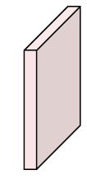
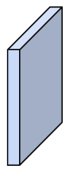
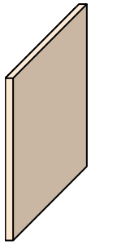
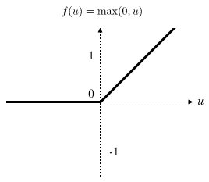
Convolutional layer
Convolution itself is a linear kind of operation. There is a need to add at the end of the convolution layer a non-linear layer, called ReLU activation. ReLU is the max function(x,0) with input x matrix from a convolved image. ReLU then sets all negative values in the matrix x to zero and all other values are kept constant.
Image
32
28
24
Conv + ReLU
(7 of 5 * 5 * 3 filters)
Conv + ReLU
(8 of 5 * 5 * ? filters)
Conv + ReLU
32
28
24
3
7
8

Slide 12
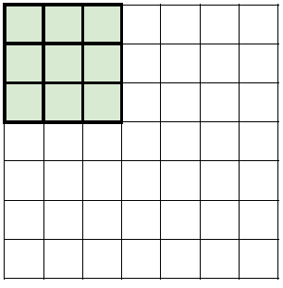
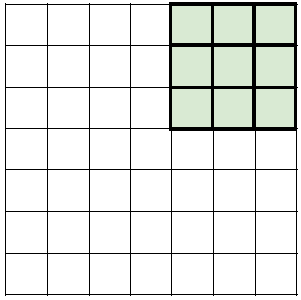
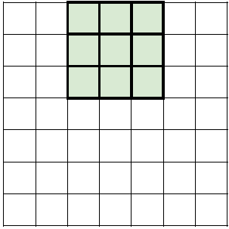
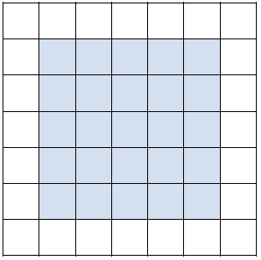
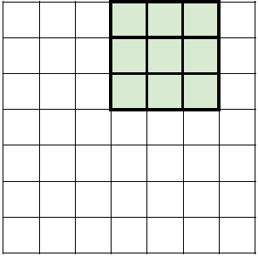
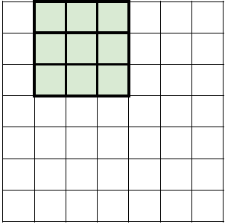
Convolutional Neural Networks: A Closer look
Input image: 7 * 7
Filter size: 3 * 3
Stride: 1
Output: 5 * 5

Slide 13
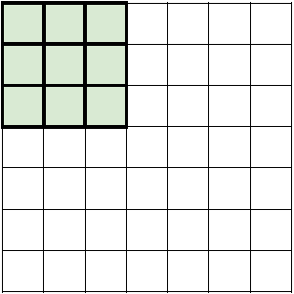
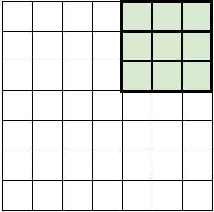
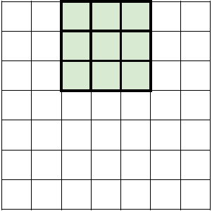
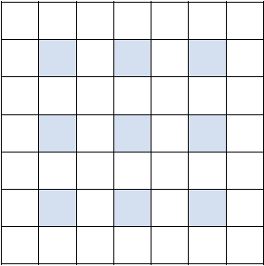
Convolutional Neural Networks: A Closer look
Input image: 7 * 7
Filter size: 3 * 3
Stride: 2
Output: 3 * 3

Slide 14
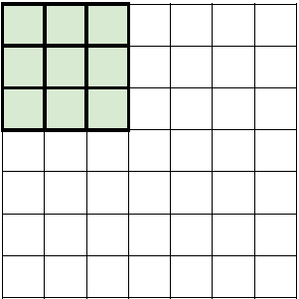
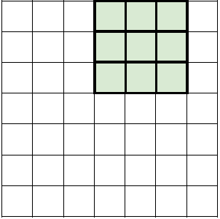

Convolutional Neural Networks: A Closer look
Input image: 7 * 7
Filter size: 3 * 3
Stride: 3

Slide 15
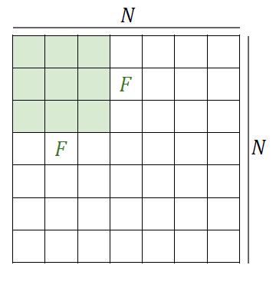
Convolutional Neural Networks: A Closer look
Output Size = (N – F) / Stride + 1
N = 7 F = 3
Stride = 1 Output Size = (7 – 3) / 1 +1 = 5
Stride = 2 Output Size = (7 – 3) / 2 + 1 = 3
Stride = 3 Output Size = (7 – 3) / 3 +1 = 2.33
Image from: http://cs231n.github.io/convolutional-networks/

Slide 16
Convolutional Neural Networks
We are condensing the data spatially! Too fast! What does that mean?
Image
32
28
24
32
28
24
3
7
8
Solution?
Zero Padding (pad): Add zeros on the image border to let the convolution output size be the same as the input image size.

Slide 17

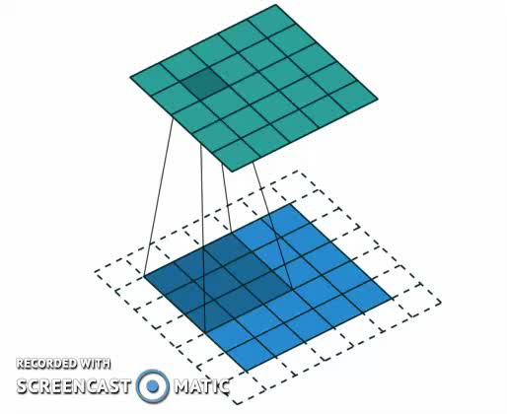
Convolutional Neural Networks
Input Size: 4 * 4
Filter Size: 3 * 3
Stride: 1
Padding: 0 (No Padding)
Input Size: 5 * 5
Filter Size: 3 * 3
Stride: 1
Padding: 1
Image from: https://leonardoaraujosantos.gitbooks.io/artificial-inteligence/content/convolutional_neural_networks.html

Slide 18
Convolutional Neural Networks
Convolutional Layer:
It takes a data volume of size W₁ * H₁ * D₁
Hyper Parameters:
Number of Filters (K)
Filter Size (F)
Stride (S)
Zero Padding (P)
Common Configurations:
K = 32, 64, 128, …
F = 3, S = 1, P = 1
F = 5, S = 1, P = 2
F = 5, S = 2, P = 2

Slide 19
Max Pool (Pooling)
It performs downsampling across the spatial dimensions (width, height). The representation would be smaller and more manageable.
100 * 100 * 128
50 * 50 * 128

Slide 20
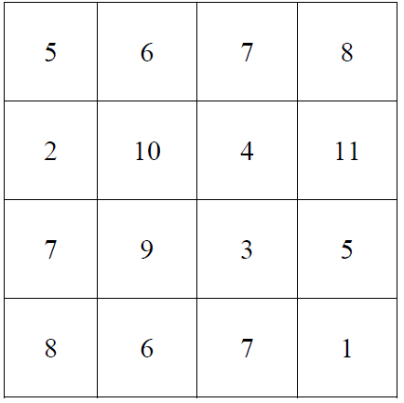
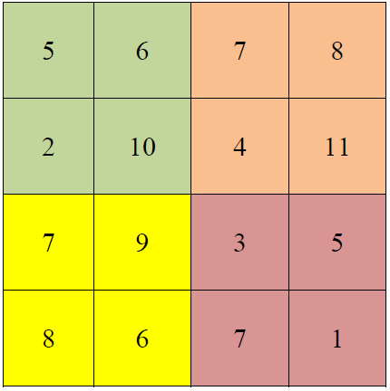
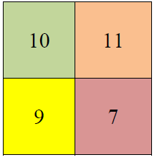
Max Pool (Pooling): How it works?
Filter Size: 2 * 2
Stride: 2

Slide 21
Convolutional Neural Networks
Max Pool Layer:
It takes a data volume of size W₁ * H₁ * D₁
Hyper Parameters:
Filter Size (F)
Stride (S)
Common Configurations:
F = 2, S = 2
F = 3, S = 2

Slide 22
Fully connected layer
It computes the class scores.
This layer takes an input volume (the output of the Conv + ReLU + Pooling layer preceding it) and outputs an N dimensional vector, where N is the number of classes that we want to choose. For example, if we want to develop an object detection for Doors, Stairs, and Signs, then N would be 3.
Each number in this N dimensional vector shows the probability of a class. For example, if the resulting vector for is [.1 .1 .80] for [Doors, Stair, Sign], then this represents a 10% probability that the image is a door, 10% probability that the image is a stair, and 80% probability that the image is sign.

Slide 23
CNN Architecture: Review
Input: In our scenario, it holds the raw pixel values of an image (e.g., an image of width 32, height 32, and with three color channels R,G,B).
Convolutional Layer: This layer filters (convolve) the inputs to provide very useful information appropriate for object modeling. These convolutional layers help to automatically extract the most valuable information for the task at hand without human designed feature selection. This layer will result in data volume such as [32 * 32 * 16] if we used for example 16 filters.
ReLU Layer: will apply a pixelwise activation function, such as the max(0,x) thresholding at zero. This layer keeps the size of the data volume unchanged (e.g., [32 * 32 * 16]).
Pooling Layer: It does a downsampling operation across the spatial dimensions (width, height), and will result in data volume such as [16 * 16 * 16].
Fully Connected Layer: This layer computes the class scores, and it will result in volume of size [1 * 1 * 3], where each of those 3 numbers correspond to a class score, such as among the 3 categories (doors, stairs, signs).

Slide 24
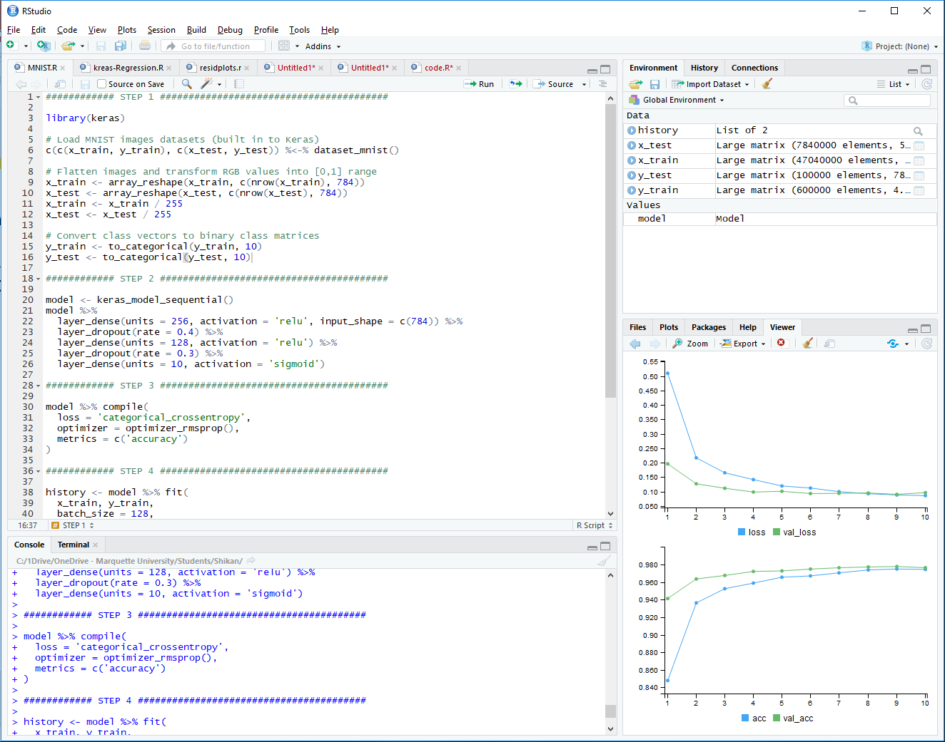
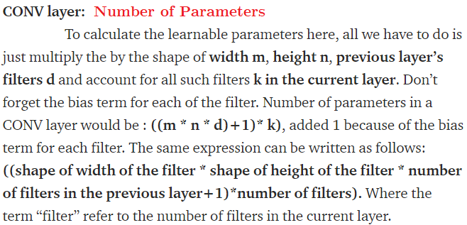
Keras Demo (Mnist CNN)
https://keras3.posit.co/articles/examples/vision/mnist_convnet.html

Slide 25

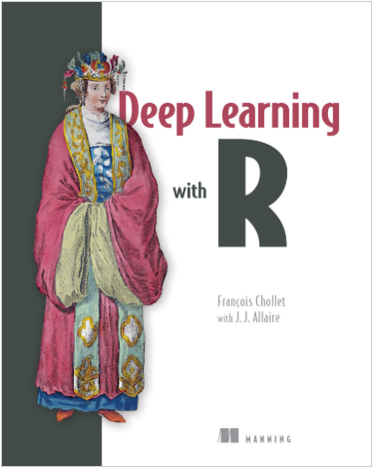
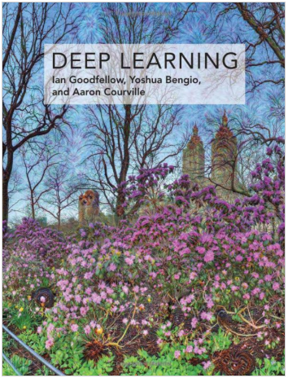

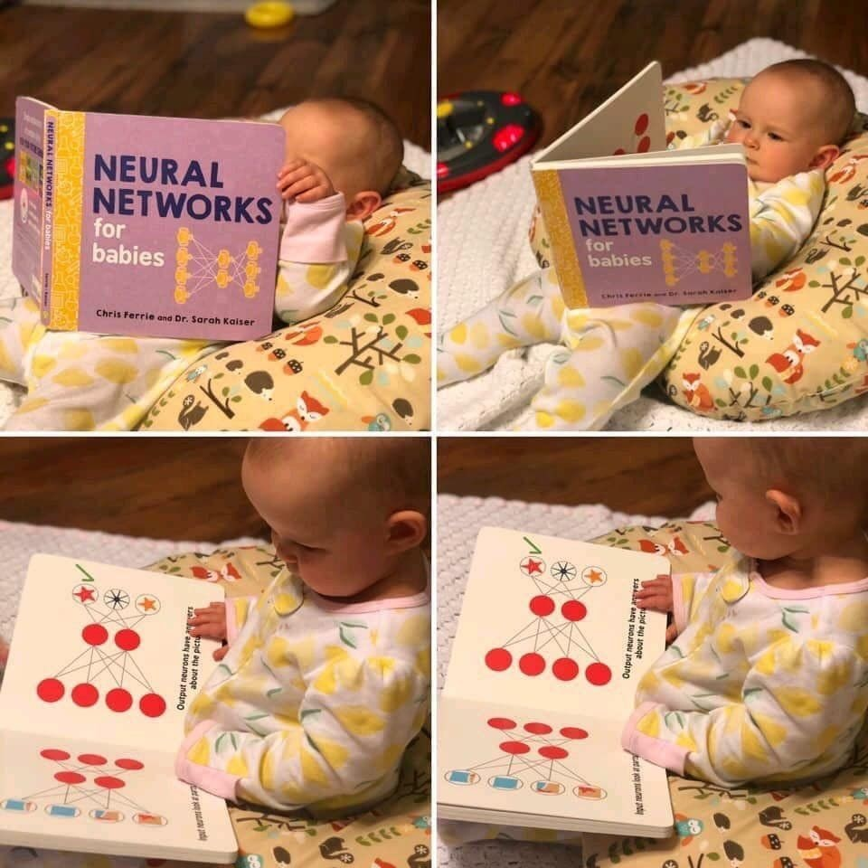
References
QUESTIONS? THANK YOU!

Slide 26
Appendix
Neural Network with Linear activation function

Slide 27
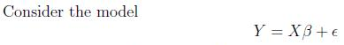
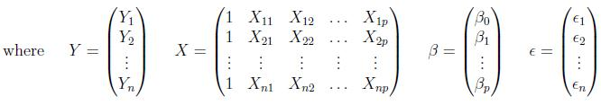
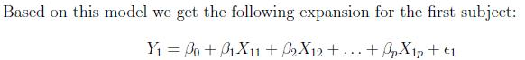
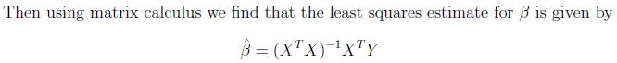
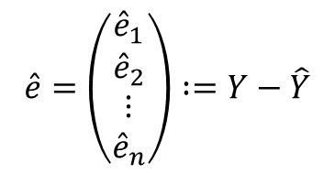
Linear Model – Best Linear Unbiased Est.
In R:
lm.fit <- lm(Y~X)
Y.hat <- lm.fit$fitted
e.hat <- lm.fit$resid
$$\hat{e}=\left(\begin{matrix}{\hat{e}}_{1} \\ {\hat{e}}_{2} \\ \begin{matrix}⋮ \\ {\hat{e}}_{n}\end{matrix}\end{matrix}\right) :=Y−\hat{Y}$$

Slide 28
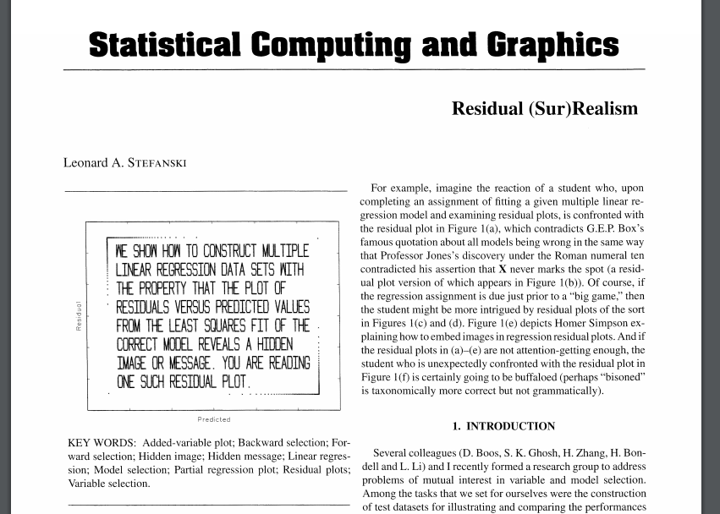
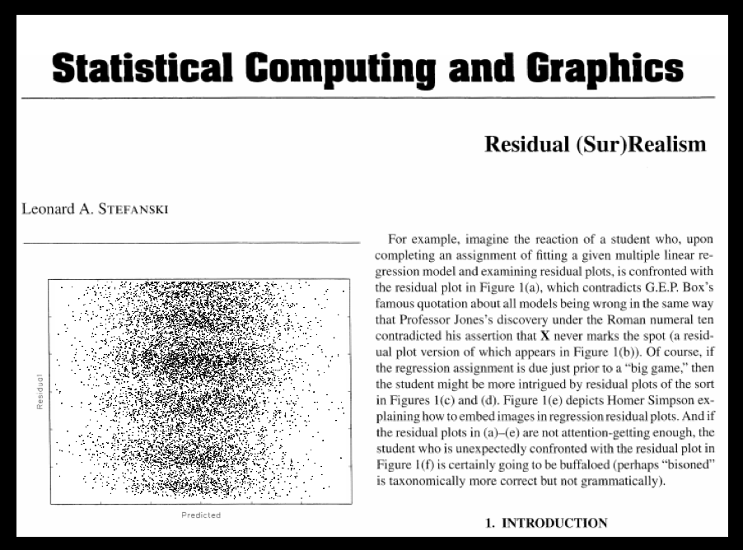
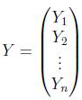
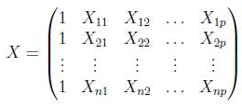

Redidual (Sur)Realism – Reverse Inverse Problem
The end user provides $\hat{e}=\left(\begin{matrix}{\hat{e}}_{1} \\ {\hat{e}}_{2} \\ \begin{matrix}⋮ \\ {\hat{e}}_{n}\end{matrix}\end{matrix}\right)$ and $\hat{Y}=\left(\begin{matrix}{\hat{Y}}_{1} \\ {\hat{Y}}_{2} \\ \begin{matrix}⋮ \\ {\hat{Y}}_{n}\end{matrix}\end{matrix}\right)$
Redidual (Sur)Realism provides (generates)
and

Slide 29






Redidual (Sur)Realism – Simulation
Here $\hat{e}$ and $\hat{Y}$ are vectors of length $10118$
Using “Redidual (Sur)Realism” we generate
$X=\left[\begin{matrix}X_{1} & X_{2} & \begin{matrix}⋯ & X_{5}\end{matrix}\end{matrix}\right]$ and $Y$, where $X_{j}$’s and $Y$ are vectors of length $10118$
For interested readers:
Regression Shiny App
Code to generate similar data
“mu-logo.csv”
Residual plot
$$\hat{e}$$
mu.logo <- data.frame(read.csv("mu-logo.csv"))
lm.fit <- lm(Y~X1+X2+X3+X4+X5, data=mu.logo)
plot(lm.fit$fitted.values, lm.fit$residuals)
$$\hat{Y}$$

Slide 30
Some Deep Learning Packages in R
R Package | Description
nnet | Software for feed-forward neural networks with a single hidden layer, and for multinomial log-linear models.
neuralnet | Training of neural networks using backpropagation
h2o | R scripting functionality for H2O
RSNNS | Interface to the Stuttgart Neural Network Simulator (SNNS)
tensorflow | Interface to TensorFlow
deepnet | Deep learning toolkit in R
darch | Package for Deep Architectures and Restricted Boltzmann Machines
rnn | Package to implement Recurrent Neural Networks (RRNs)
FCNN4R | Interface to the FCNN library that allows user-extensible ANNs
rcppDL | Implementation of basic machine learning methods with many layers (deep learning), including dA (Denoising Autoencoder), SdA (Stacked Denoising Autoencoder), RBM (Restricted Boltzmann machine) and DBN (Deep Belief Nets)
deepr | Package to streamline the training, fine-tuning and predicting processes for deep learning based on darch and deepnet
MXNetR | Package that brings flexible and efficient GPU computing and state-of-art deep learning to R
Ref: https://www.datacamp.com/community/tutorials/keras-r-deep-learning

Slide 31





Regression using Neural Network
library("neuralnet");
net1 <- neuralnet(Y~X1+X2+X3+X4+X5, data=mu.logo, hidden=0, act.fct=function(x) {x})
plot(net1)
net2 <- neuralnet(Y~X1+X2+X3+X4+X5, data=mu.logo,
hidden=10, act.fct=function(x) {x})
plot(net2)
net3 <- neuralnet(Y~X1+X2+X3+X4+X5, data=mu.logo,
hidden=c(10,10),
act.fct=function(x) {x})
plot(net3)
errors <- c(net1$result.matrix[1],
net2$result.matrix[1],
net3$result.matrix[1])

Slide 32




Linear Activation function –
Hidden Layers Disappears
$Z=W_{1}X+b_{1}$
$Y=W_{2}Z+b_{2}$
$Y=W_{2}\left\{W_{1}X+b_{1}\right\}+b_{2}$
$$=\left\{W_{2}W_{1}\right\}X+W_{2}b_{1}+b_{2}$$

Slide 33


Linear Activation function –
Hidden Layers Disappears
$Z=W_{1}X+b_{1}$
$Y=W_{2}Z+b_{2}$
$Y=W_{2}\left\{W_{1}X+b_{1}\right\}+b_{2}$
$$=\left\{W_{2}W_{1}\right\}X+W_{2}b_{1}+b_{2}$$

Slide 34

Linear Regression using Neural Network
par(mfrow=c(2,2))
plot(lm.fit$fitted.values,lm.fit$residuals)
plot(net1$net.result[[1]], net1$data$Y-net1$net.result[[1]])
plot(net2$net.result[[1]], net1$data$Y-net2$net.result[[1]])
plot(net3$net.result[[1]], net1$data$Y-net3$net.result[[1]])
Track the estimated weights (last slide):
lm.fit$coefficients
(Intercept) X1 X2 X3 X4 X5
0.9761 0.1886 0.1204 0.947 0.0123 0.9670
net1$weights[[1]][[1]]
net2$weights[[1]][[1]]%*%net2$weights[[1]][[2]][-1,]+
c(net2$weights[[1]][[2]][1,],rep(0,5))
net3$weights[[1]][[1]]%*%net3$weights[[1]][[2]][-1,]%*%
net3$weights[[1]][[3]][-1,]+
c(net3$weights[[1]][[2]][1,]%*%
net3$weights[[1]][[3]][-1,]+
net3$weights[[1]][[3]][1,],rep(0,5))
[,1]
[1,] 0.97616933628
[2,] 0.18860735193
[3,] 0.12038303654
[4,] 0.94771369991
[5,] 0.01233217481
[6,] 0.96709890209
[1,] 0.97612914391
[2,] 0.18860673427
[3,] 0.12037904524
[4,] 0.94767200973
[5,] 0.01233279789
[6,] 0.96705727512
[1,] 0.97612498212
[2,] 0.18860596835
[3,] 0.12037855729
[4,] 0.94766806847
[5,] 0.01233289235
[6,] 0.96705341702

Slide 35



Neural Network
mulogo <- data.frame(cbind(mu.logo, matrix(rnorm(prod(dim(net1$covariate))),nc=5)) )
net4 <- neuralnet(Y~X1+X2+X3+X4+X5+X1.1+X2.1+X3.1+X4.1+X5.1, data=mulogo,
hidden=0,linear.output=TRUE, act.fct=function(x) {x})
plot(lm.fit$fitted.values, lm.fit$residuals)
plot(net4$net.result[[1]], net4$data$Y-net4$net.result[[1]])
plot(net4)
Function “neuralnet” Arguments:
neuralnet(formula, data, hidden = 1,
threshold = 0.01, stepmax = 1e+05, rep = 1,
startweights = NULL,
learningrate = NULL, learningrate.limit = NULL,
algorithm = "rprop+",
err.fct = "sse",
act.fct = "logistic",
exclude = NULL, constant.weights = NULL)
algorithm : The following algorithms are possible:
'backprop' : backpropagation
'rprop+' : the resilient backpropagation with weight backtracking
'rprop-' : the resilient backpropagation without weight backtracking
'sag' and 'slr' : induce the usage of the modified globally convergent algorithm (grprop)
err.fct : 'sse' and 'ce' or a differentiable function that is used for the calculation of the error
act.fct : 'logistic' and 'tanh' or a user defined differentiable activation function

